Slide 1
CORERO FY 2023
RESULTS
Carl Herberger, CEO
Phil Richards, CFO
May 2024

Slide 2
Safe Harbour
Forward-looking Statements
This announcement may contain “forward-looking statements” within the meaning of Section 27A of the Securities Act of 1933 and Section 21E of the Securities Exchange Act of 1934. We intend all forward-looking statements to be covered by the safe harbor provisions of the Private Securities Litigation Reform Act of 1995. Forward-looking statements generally can be identified by the fact that they do not relate strictly to historical or current facts and by the use of forward-looking words such as “expect,” “expectation,” “believe,” “anticipate,” “may,” “could,” “intend,” “belief,” “plan,” “estimate,” “target,” “predict,” “likely,” “seek,” “project,” “model,” “ongoing,” “will,” “should,” “forecast,” “outlook” or similar terminology. These statements are based on and reflect our current expectations, estimates, assumptions and/ or projections, our perception of historical trends and current conditions, as well as other factors that we believe are appropriate and reasonable under the circumstances. Forward-looking statements are neither predictions nor guarantees of future events, circumstances or performance and are inherently subject to known and unknown risks, uncertainties and assumptions that could cause our actual results to differ materially from those indicated by those statements. There can be no assurance that our expectations, estimates, assumptions and/or projections, including with respect to the future earnings and performance or capital structure of Corero Network Security plc, will prove to be correct or that any of our expectations, estimates or projections will be achieved

Slide 3
About
Corero Network Security
A leading provider of distributed denial of service ‘DDOS’ software solutions
Delivers tailored intelligently automated solutions that protects from DDoS attacks in under a second
Key strategic and technology partnerships with global companies including Akamai Technologies, Juniper Networks, and GTT.
Actively servicing internet service providers, hosting providers, SaaS providers, cloud providers, and edge providers
Headquartered in London with offices near Boston and in Edinburgh
Listed on London AIM (Ticker: CNS) and US OTCQB (Ticker: DDOSF)

Slide 4

FY 2023
A YEAR OF ONGOING PROGRESS
Secured strategic go-to-market partnership with Akamai
Announced Carl Herberger as new CEO in H2 2023
Launched SmartWall ONETM platform and product update 12.0 during H2 2023
Secured $1 million plus contract with new channel partner customer, TechEnabler, in Brazil
Continued growth in the company's subscription-based products and DDoS protection-as-a-service ("DDPaaS") offering, underpinning revenue and earnings predictability

Slide 5


OUR BUSINESS
IN NUMBERS
$22.3MM
$2.2MM
$16.9MM
90%
REVENUE
+11% YOY
ADJUSTED EBITDA
+29% YOY
ARR
+17% YOY
GROSS MARGIN
97%
80
50+
CUSTOMER RENEWAL RATE
PEOPLE WORLDWIDE
COUNTRY FOOTPRINT
Notes:
75% of DDoS attacks last less than 10 minutes:
ATTACK ENDS BEFORE THE PROVIDER IS AWARE
PROVIDER UNAWARE UNTIL CUSTOMERS COMPLAIN
98% are less than 10Gbps
UPSTREAM PROVIDER CAN ABSORB THE TRAFFIC
ROOT CAUSE ANALYSIS IS MORE DIFFICULT
LACK OF VISIBILITY FROM CLOUD SOLUTIONS
300% increase in carpet bomb/spread spectrum attacks:
LOW TRAFFIC VOLUME EVADES THRESHOLD-BASED MONITORING
BLACK HOLE TECHNIQUE IS IMPRACTICAL
CLOUD-BASED SCRUBBING IS EXPENSIVE
27% likelihood of repeat attack:
ATTACKERS PREFER PATH OF LEAST RESISTANCE
REPEATED ECONOMIC IMPACT FOR VICTIMS

Slide 6

INVESTMENT
‘Service availability is fundamental for all businesses in today’s world’
CASE
$3.6bn addressable market and growing at pace
Next-gen, market-leading, disruptive technology
Significantly enhanced unique capability compared to competition
Experienced management team with extensive market and competitor knowledge and experience
Ongoing R&D investment propelling new services and product deployments
Growing channel partner footprint, notably with Akamai, capable of accelerating growth
6
Notes:
75% of DDoS attacks last less than 10 minutes:
ATTACK ENDS BEFORE THE PROVIDER IS AWARE
PROVIDER UNAWARE UNTIL CUSTOMERS COMPLAIN
98% are less than 10Gbps
UPSTREAM PROVIDER CAN ABSORB THE TRAFFIC
ROOT CAUSE ANALYSIS IS MORE DIFFICULT
LACK OF VISIBILITY FROM CLOUD SOLUTIONS
300% increase in carpet bomb/spread spectrum attacks:
LOW TRAFFIC VOLUME EVADES THRESHOLD-BASED MONITORING
BLACK HOLE TECHNIQUE IS IMPRACTICAL
CLOUD-BASED SCRUBBING IS EXPENSIVE
27% likelihood of repeat attack:
ATTACKERS PREFER PATH OF LEAST RESISTANCE
REPEATED ECONOMIC IMPACT FOR VICTIMS

Slide 7


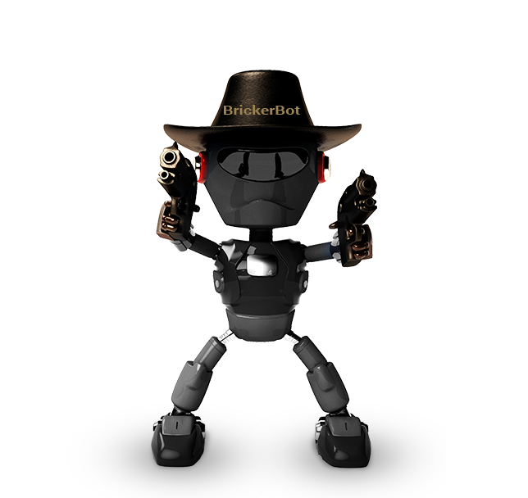
Botnets fueling cyber attacks globally
Mirai
Hajime
BrickerBot
Botnets can initiate illegal tasks including sending spam, data theft and DDoS attacks.
Corero provides cost-effective solutions to ensure customer uptime and availability.

Slide 8
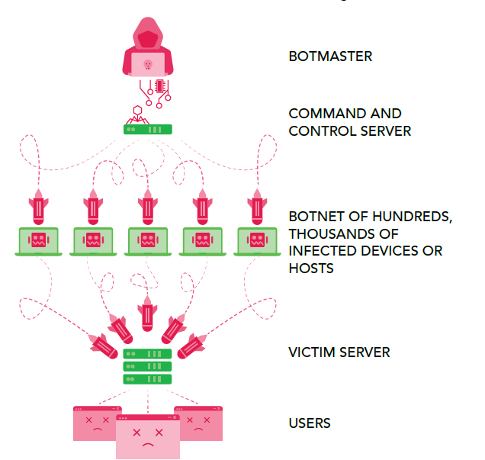
Example of A
DDoS Botnet Attack
1
Botmaster sends “LAUNCH” command.
2
Bots send attack traffic to victim.
3
Attack traffic overwhelms the victim
server or network.

Slide 9


OUR PRODUCT PROPOSITION
SMARTWALL ONE
Hybrid Cloud
On-Premises
Our hybrid cloud solution is all about making things seamless and giving you that sturdy shield against DDoS attack, no matter how you slice it.
Fast, automated DDoS protection that fits any setup, hardware or virtual. With seamless integration, keep your service smooth and uninterrupted, no matter your network.
Scale-proof protection
Fast and automated mitigation
Lower ownership costs
Full attack visibility
Near-instant defense
Comprehensive network visibility
Uninterrupted business continuity
24/7 expert support
Q1 2024 Launch of Corero DDoS Intelligence Service
Automated, AI-assisted subscription service for Corero SmartWall ONE customers
Delivers pre-emptive attack mitigation before the first attack is even detected.
Notes:
75% of DDoS attacks last less than 10 minutes:
ATTACK ENDS BEFORE THE PROVIDER IS AWARE
PROVIDER UNAWARE UNTIL CUSTOMERS COMPLAIN
98% are less than 10Gbps
UPSTREAM PROVIDER CAN ABSORB THE TRAFFIC
ROOT CAUSE ANALYSIS IS MORE DIFFICULT
LACK OF VISIBILITY FROM CLOUD SOLUTIONS
300% increase in carpet bomb/spread spectrum attacks:
LOW TRAFFIC VOLUME EVADES THRESHOLD-BASED MONITORING
BLACK HOLE TECHNIQUE IS IMPRACTICAL
CLOUD-BASED SCRUBBING IS EXPENSIVE
27% likelihood of repeat attack:
ATTACKERS PREFER PATH OF LEAST RESISTANCE
REPEATED ECONOMIC IMPACT FOR VICTIMS

Slide 10
CHANNEL & SALES
PARTNERS
Global Channel Alliances:
Akamai
Juniper
GTT
TDL Gentek
Axians
Ingecom
Kite
Multipoint
Beyondtech
Netceed
Eplus
Myriad 360
Datacipher
Denotes regional partner
Techenabler
CDM

Slide 11

FINANCIAL SUMMARY

Slide 12

FINANCIAL
REVENUE
$22.3MM
ARR¹
$16.9MM
GROSS MARGiN
90.0%
HIGHLIGHTS
2019 $9.7m
2019 $7.2m
2019 81.0%
2020 $16.9m
2020 $9.8m
2020 77.3%
2021 $20.9m
2021 $12.8m
2021 85.1%
2022 $20.9m
2022 $14.4m
2022 87.2%
2023 $22.3m
2023 $16.9m
2023 90.0%
NET CASH
$5.2MM
ADJUSTED EBITDA²
$2.2MM
PROFIT/(LOSS) BEFORE TAXATION
-$0.2MM
2019 $5.4m
-$2.5m 2019
-$6.6m 2019
2020 $7.6m
2020 $0.6m
-$4.0m 2020
2021 $8.4m
2021 $3.2m
2021 $1.4m
2022 $4.4m
2022 $1.7m
2022 $0.4m
2023 $5.2m
2023 $2.2m
2023 -$0.2m
Notes:
75% of DDoS attacks last less than 10 minutes:
ATTACK ENDS BEFORE THE PROVIDER IS AWARE
PROVIDER UNAWARE UNTIL CUSTOMERS COMPLAIN
98% are less than 10Gbps
UPSTREAM PROVIDER CAN ABSORB THE TRAFFIC
ROOT CAUSE ANALYSIS IS MORE DIFFICULT
LACK OF VISIBILITY FROM CLOUD SOLUTIONS
300% increase in carpet bomb/spread spectrum attacks:
LOW TRAFFIC VOLUME EVADES THRESHOLD-BASED MONITORING
BLACK HOLE TECHNIQUE IS IMPRACTICAL
CLOUD-BASED SCRUBBING IS EXPENSIVE
27% likelihood of repeat attack:
ATTACKERS PREFER PATH OF LEAST RESISTANCE
REPEATED ECONOMIC IMPACT FOR VICTIMS

Slide 13
CAPITAL STRUCTURE
FY 2023
Cash | $5.2MM
Market Cap | £71MM
Shares Outstanding | 508MM
Warrants | None
Options | 60MM (as of December 31)
RSUs | None
Fully Diluted | 568MM
Convertible Notes | None
52 wk H/L | 15.00p – 5.50p
Shareholder Distribution
Insiders | 38%
Retail | ~10%
Other Large Shareholders | 53%

Slide 14

Key Financial Metrics
FY 2023 (audited)
ARR CAGR of 24% 1 Jan 2019 – 1 Jan 2024
11% YOY revenue increase to $22.3MM
2023 EBITDA: $2.2MM
Cash generative, Debt free
YE cash balance: $5.2MM

Slide 15
KEY FINANCIAL METRICS
REVENUE 2023
USA: $15.9MM / 71%
(2022: $13.5MM / 67%)
UK/ROW: $6.5MM / 29%
(2022: $6.6MM / 33%)

Slide 16

STRATEGY & OUTLOOK

Slide 17




DELIVERING ACROSS
FOUR REVENUE GENERATING ACTIVITIES
Investment in targeted marketing and sales initiatives
Expand sales partnerships and global alliances
Upsell opportunities within current installed base
Renewals and current customer expansion
17

Slide 18

CORERO NETWORK SECURITY
OUTLOOK
Strong start to 2024 with robust new business pipeline already delivering results in H1 2024
  $1.8MM new business deal with Tierpoint signed in April 2024
  $2MM+ contract renewal and expansion with global US based SaaS provider
Expansion of strategic partnership with Ingecom, allowing Corero to enhance its European footprint
Commenced trading on the US OTCQB venture market under ticker symbol "DDOSF" in February 2024
Demand remains strong across the market driven by the relentless growth in DDOS attacks globally

Slide 19

THANK YOU
phil.richards@corero.com
carl.herberger@corero.com

